Slide 1
SAS Final Project
BY: Luke Faro, Larry Agyei, Elijah Eberly, Shane Artis

Slide 2

Project Background
Group Interest in NBA statistics
Obtained NBA data from Kaggle for the years 2004-2022
Used the games.csv file to accurately predict team wins
Data can be used to help coaches, players, and spectators

Slide 3

Data Description
NBA games.csv file
Data contained games from 2004 - 2022
Some missing data, no outliers
Used a filter and data partition node to reduce the noise
Variables include:
date, team, points both home and away
assists and rebounds home and away

Slide 4
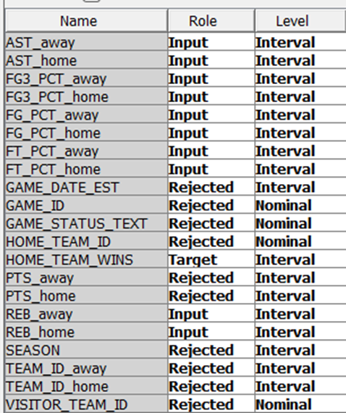
Data Prep
Stat Explore Node
Gave insight on missing data (18726 out of 81274)
Mean, Skewness, and Standard Deviation
Cluster / Variable Cluster
Set final maximum to 5
Helps remove collinearity, redundancy
Able to see how variables are grouped

Slide 5
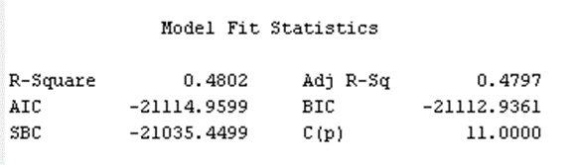
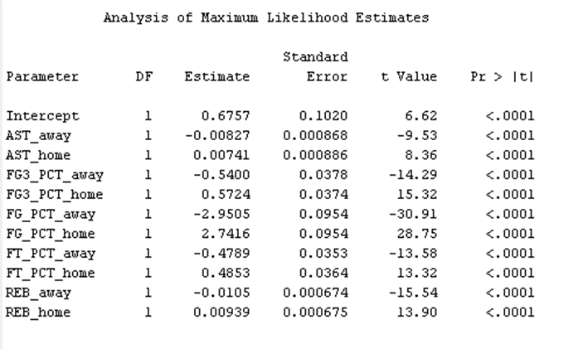
Model Tests
Logistic Regression
Using Home_Team_Wins as Target Variable
We used four different nodes
First the file import node
Filter node
Data Partition node
Regression node
Resulted in a R-squared of 48.02%
All variables were significant as they are less than .05

Slide 6
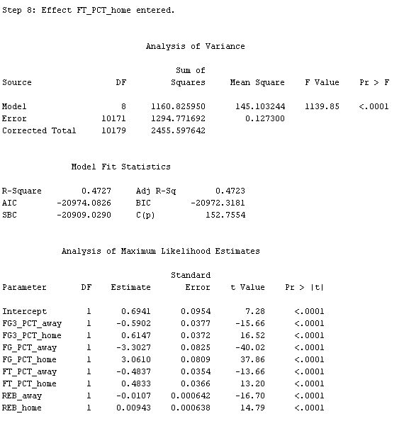
Model Tests
Stepwise logistic regression
Starts with most significant adding more variables each time
The most significant variables was field goal percentage home and away
Field goal pct home and away resulted R-squared of 39.37%
Stopped at step 8 as no more significant improvement
Resulted in overall R-squared of 47.27%

Slide 7
Model Tests
Backwards Logistic Regression
Removes least important variables and leaves the most important variables
Results were the same as original model
R-squared of 48.02%
All variables were significant as they are less than .05

Slide 8
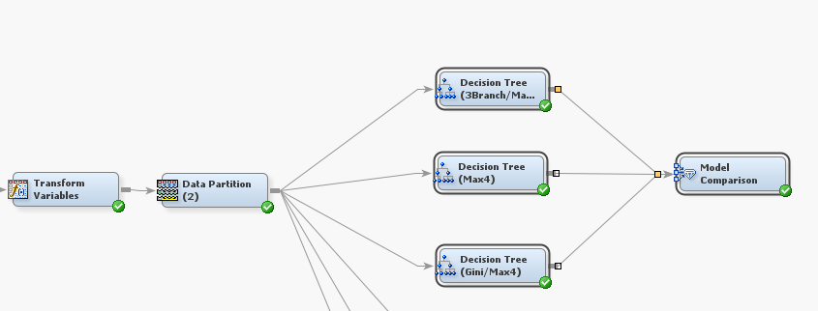
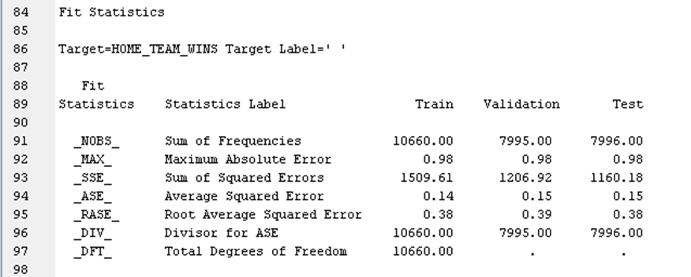
Model Tests
Decision Tree
Set Maximum depth to 4 everything else left unchanged for first pass
Used import file, transform variables, data partition and then a decision tree
Field goal percentage away was most important followed by field goal percentage home
Average Square Error (ASE) of 15% resulting in 85% accuracy rate

Slide 9
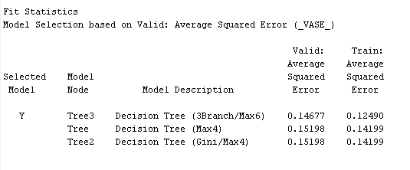
Model Tests
Decision Tree
Set 3 splits per decision and having a max depth of 6 yielded improved accuracy
Changing the split method from Chi Squared to Gini slightly decreased accuracy

Slide 10
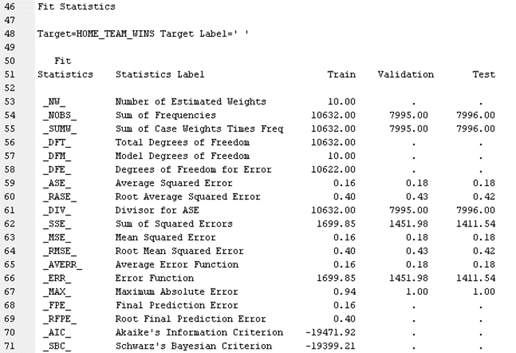
Model Tests
MBR / K-Nearest Neighbor
Using default settings on first pass
Returned an Average Squared Error of 18%
Slightly worse predictor of home team wins when compared to decision tree and linear regression models
Even with a refined model

Slide 11
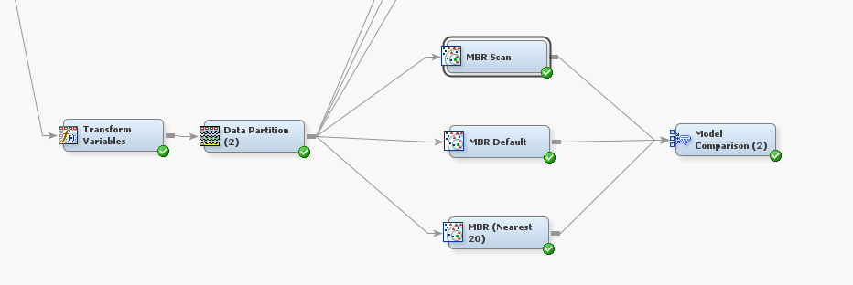
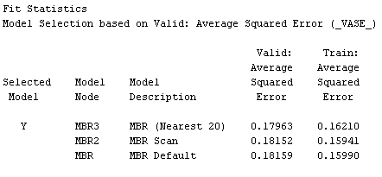
Model Tests
MBR / K-Nearest Neighbor
Increasing the number of neighbors collected improved accuracy
Changing the input method to Scan yielded marginally better results

Slide 12
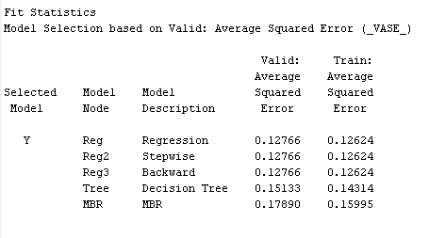
Results
Used a model comparison with all models
Original logistic regression model worked best
No models achieved less than 10 for ASE
Possibly due to missing data
MBR / KNN performed the worst
Found that Field goal percentage was most important for a team winning the game
Need to shoot more shoots

Slide 13

Results
Our findings can be used for determine success and predicting possible championship teams
Help coaches identify strengths and weaknesses
Many teams now have data scientist to help because they have seen the benefits
Example: not directly related to basketball but the movie Moneyball

Slide 14
Q & A

